Slide 1
ANALYST BOOT CAMP QUANTITATIVE ANALYSIS MARCH 2024 MUIP00071
Notes:
Through Slide 8 (00:10)
You are welcome to use a calculator or open Excel to do your work.
Instructor Notes: We will visit a topic 3 times.
Ppt slide
Khan Academy video
Practice problems in excel spreadsheet workbook.
Have students save a local copy of the workbook spreadsheet for participation. Open spreadsheet and save a copy.

Slide 2
HOUSEKEEPING
Actively participate; Do not multitask or do other things during class time.
Close other applications (including email).
Be prepared to hear your name.
Use the “raise your hand button” when you have questions.
We will use a “parking lot” for questions that are out of scope for this class.
I will frequently ask “does everyone follow that” because I can’t see your faces.

Slide 3
PRE-TEST
2 X 2 + 2 X 2
Rebase the series to the last number: 5, 7, 15, 12, 6
What are the first 2 terms of a MA2 for the series above:
The average is a measure of the __________ of a set of data.
The standard deviation is a measure of _____________
Given a Normal Distribution with mean=100 and standard deviation=15, what are the Z-scores that include 95% of the data values? ______
Explain the Central Limit Theorem? ___________
Advanced
Given a data set of 15 values should we use the z-score or t-score? __
The most common level of significance used for Confidence Intervals is: __

Slide 4
COURSE GOALS
Develop an understanding of Analytical concepts.
Demonstrate that understanding by solving practical problems using Excel.

Slide 5
QUANTITATIVE ANALYSIS BASICS
Order of Operations, Square Roots, Exponents
Calculation of Average – Mean, Median, Mode
Calculation of Standard Deviation
Weighted Average
Moving Average
Growth Rate
Indexing
Rebasing

Slide 6


SYMBOLS
Arithmetic Symbols
Multiplication$∗$ $×$ $∙$
Division / $\frac{a}{b}$ $÷$
Parentheses ( )
Brackets [ ] { }
Exponents $x$ ^ 2, $x$²
Subscripts $x$₁ , $x$₂
Logical Symbols
$=$ Equal to
$≠$ Not Equal to
≤ Less than or equal to
$≥$ Greater than or equal to
$<$ Less than
$>$ Greater than

Slide 7
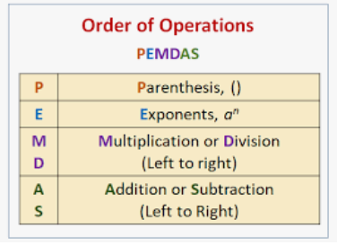
ORDER OF OPERATIONS (PEMDAS)
The Order of Operations matters because we can get different answers to the same problem.
Mathematicians agree to use PEMDAS.
Multiplication is not ranked before division, as M before D might suggest. They are ranked equal in the 3rd tier. We work on an algebraic expression from left-to-right within the tier.
The same rules hold for addition vs. subtraction in the 4th tier.
Notes:
Please Excuse My Dear Aunt Sally

Slide 8
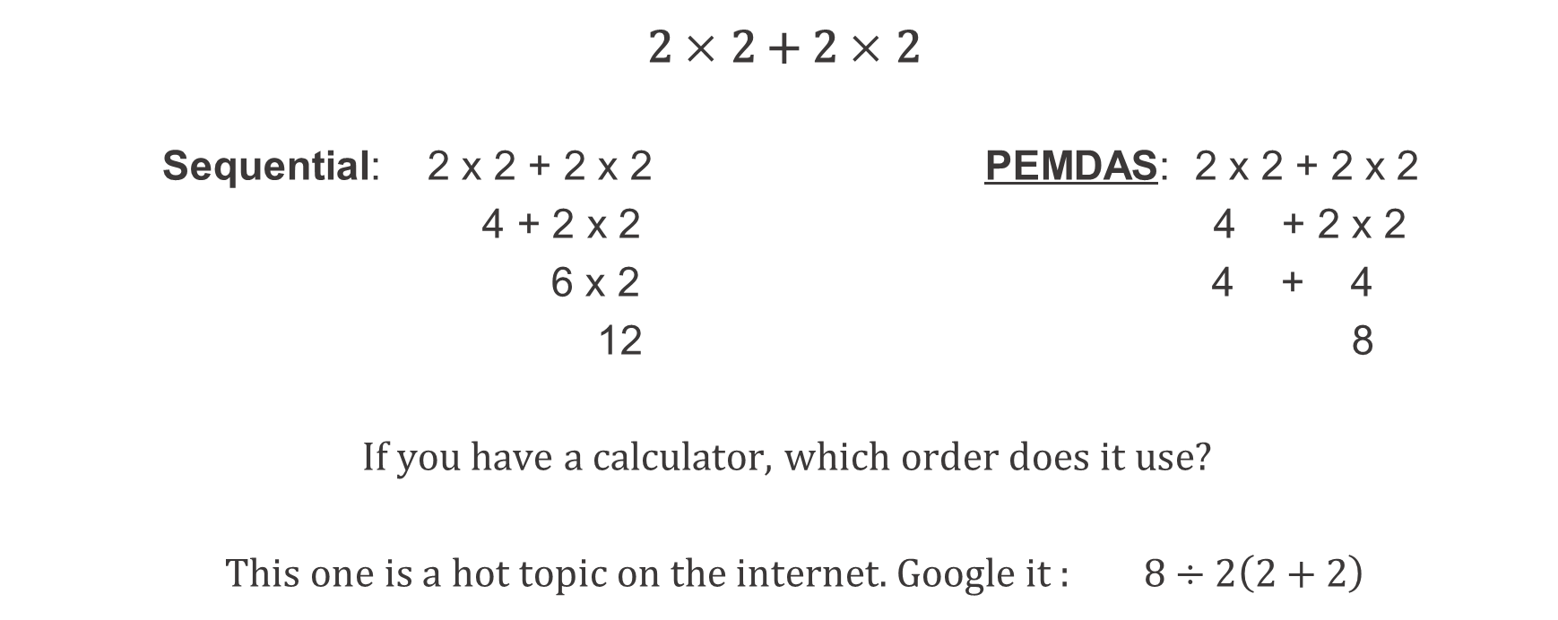
THE ORDER OF OPERATIONS MATTERS
PEMDAS
2 $×$ 2 + 2 $×$ 2
Sequential: 2 x 2 + 2 x 2 PEMDAS: 2 x 2 + 2 x 2
4 + 2 x 2 4 + 2 x 2
6 x 2 4 + 4
12 8
If you have a calculator, which order does it use?
This one is a hot topic on the internet. Google it : $8÷2\left(2+2\right)$

Slide 9
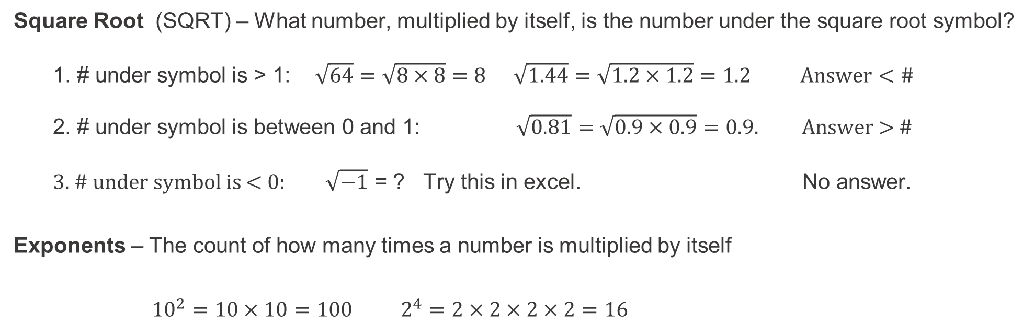
SQUARE ROOTS & EXPONENTS
Square Root (SQRT) – What number, multiplied by itself, is the number under the square root symbol?
1. # under symbol is > 1: $\sqrt{64}=\sqrt{8×8}=8$ $\sqrt{1.44}=\sqrt{1.2×1.2}=1.2$ $Answer<\#$
2. # under symbol is between 0 and 1: $\sqrt{0.81}=\sqrt{0.9×0.9}=0.9.$ Answer > #
3. # under symbol is < 0: $\sqrt{−1}$ = ? Try this in excel. No answer.
Exponents – The count of how many times a number is multiplied by itself
${10}^{2}=10×10=100$ $2^{4}=2×2×2×2=16$

Slide 10
CALCULATION OF AVERAGES
The average is a measure of “central tendency” of the data.
Example: [ 2, 2, 4, 7, 10 ]
There are 3 common types of averages, calculated as:
The MEAN: Add up the data points and then divide by the number of data points.
2+2+4+7+10 = 25 25/5 = 5 Mean = 5
The MEDIAN: Arrange the numbers in order, then pick the middle number. Median = 4
The MODE: The number that appears most often. Mode = 2. If there are no repeats,
the mode does not exist.

Slide 11
CALCULATION OF STANDARD DEVIATION (SD)
Standard Deviation (SD) is a measure of how “spread out” the data is.
The calculation uses PEMDAS, Square Roots, and Exponents.
Ex 1. ( 2, 2, 4, 7, 10 ) has a mean of 5. SD is a measure of the deviations from 5.
SD = SQRT ( ( (2-5)^2 + (2-5)^2 + (4-5)^2 + (7-5)^2 + (10-5)^2 ) / 5 )
= SQRT ( ( 9 + 9 + 1 + 4 + 25 ) / 5 )
= SQRT (48/5) = SQRT (9.6) = 3.10
Ex 2. To compare, ( 3, 4, 5, 6, 7 ) also has a mean of 5, but the SD is:
SD = SQRT ( ( (3-5)^2 + (4-5)^2 + (5-5)^2 + (6-5)^2 + (7-5)^2 ) / 5 )
SD = SQRT ( ( 2^2 + 1^2 + 0^2 + 1^2 + 2^2 ) / 5 )
= SQRT (10/5) = SQRT (2) = 1.41
Both sets have the same mean = 5, but the first is more “spread out”, so has a bigger SD.

Slide 12
EXCEL EXERCISES
Go to the Excel exercises in your workbook. The answers are to the far right on each tab.
Tabs
OrdOps
SqR_Exp
Avg
SD

Slide 13
WEIGHTED AVERAGE
Weighted Average gives more weight to the more important segments of data.
In this fictitious example PL Direct has the
most policies, so it should be given the most
weight.
.
An Unweighted Average assumes each
Business Unit has the same importance.
Often people want to use the “average of averages” because it sounds good. But they are assuming all segments have the same weight and that is generally not a valid assumption.
Notes:
Walk through Loss Ratio Example in Excel file: Weighted Average 1.

Slide 14
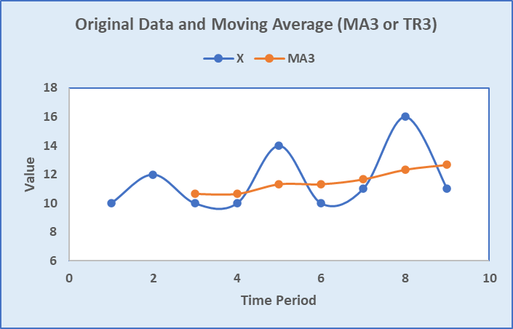
MOVING AVERAGE MAn or TRn where n = # of data points
The two purposes of a Moving Average are to
smooth out fluctuations in the data and
remove seasonality (usually MA12 or TR3) to show trend
Notes:
Analysts are consistently asked, year over year – how did it change?
What would happen if May was 32,000 and October was 23,000? A: 28% decrease.
This is a good time to show that a 50% decrease (from 32,000 to 16,000) requires a 100% increase to get back to where you started. Use excel tab.

Slide 15
GROWTH RATE
Growth Rate is the percent change of a quantity from start to end of a time period. It can be positive or negative. There are 2 ways to calculate it. You should be familiar with both.
Notes:
Analysts are consistently asked, year over year – how did it change?
What would happen if May was 32,000 and October was 23,000? A: 28% decrease.
This is a good time to show that a 50% decrease (from 32,000 to 16,000) requires a 100% increase to get back to where you started. Use excel tab.

Slide 16
GROWTH RATE
Caveat: It really doesn’t make sense to calculate the growth rate if the starting and ending values are of opposite signs (one is positive and one is negative). However, we still do it in PGR.
Notes:
Analysts are consistently asked, year over year – how did it change?
What would happen if May was 32,000 and October was 23,000? A: 28% decrease.
This is a good time to show that a 50% decrease (from 32,000 to 16,000) requires a 100% increase to get back to where you started. Use excel tab.

Slide 17
INDEXING
Divide all the numbers in a series by the first number. This sets the first number equal to 1.00
Then multiply the newly created numbers by 100. This creates an Indexed Series.
Example: Economic series (CPI, PPI)
Q1 Q2 Q3 Q4
87 95 108 120
1.00 1.09 1.24 1.38
100 109 124 138
Why do we create an index? Because it is easy to interpret:
Q2 is 9% higher than Q1
Q4 is 38% higher than Q1

Slide 18
REBASING AND RELATIVITIES
Rebase: Divide the base (reference number) by itself. This sets the Base = 1.00
Relativities: The ratios of other numbers to the base.
Many reports at PGR use “Loss Ratio Relativities” or “Pure Premium Relativities”.Here is an example where we re-base to the Total Combined Ratio (CR) and calculate relativities.
Combined Ratio is (1 – Profit Margin) and is a metric used in insurance.
Indexing is basically re-basing to the first term of the series of numbers.

Slide 19
EXCEL EXERCISES
Go to the Excel exercises. Answers are to the far right on each tab.
Tabs
WtdAvg
MovAvg
Growth Rate
Index
Rebase

